Slide 1


IBM HACK CHALLENGE 2020
Title: Sentimental Analysis of COVID-19 Tweets – Visualization Dashboard
Problem Statement:
After the extension of lockdown announcements, the sentimental analysis of Indian tweets will be analyzed with the relevant #tags and build a predictive analysis model to understand people's behavior if the lockdown is further extended. Also develop dashboard with visualization of people reaction to the government announcement to lockdown extension.
Team Name :
Team Members
Amey Band
Pritesh Dammani
Rajat Ninawe
Maroof Ahmad

Slide 2
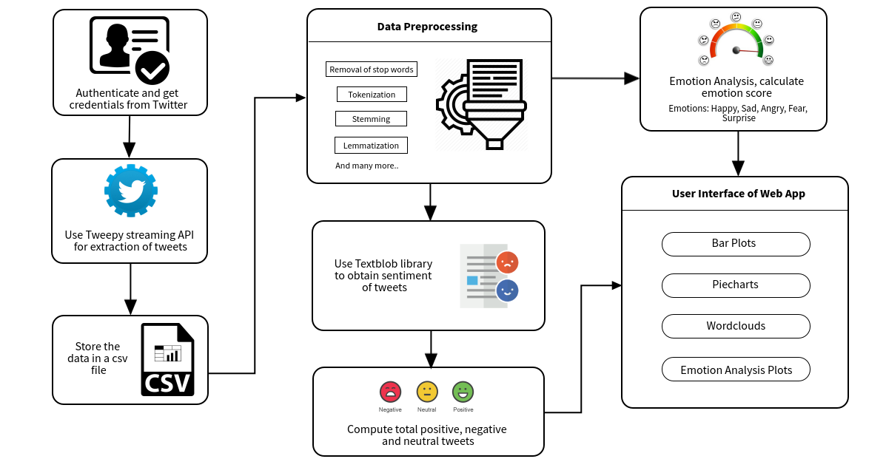
Architecture:

Slide 3
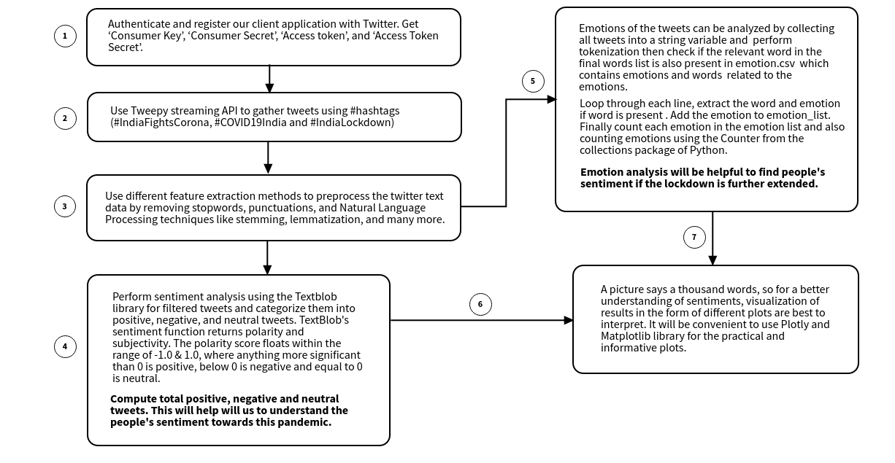
Process Flow:

Slide 4

Key Functionalities of Proposed solution:
Data is fetched from twitter using #IndiaFightsCorona, #IndiaLockdown and #COVID19India.
Extracted Hindi tweets are translated into English language using Textblob translate.
Emotion analysis is helpful to understand people’s psychological state during the lockdown.
Show geocode location of the user using Geopandas.
Day to day sentiment analysis of tweets to interpret the people’s opinion just after the government announcement related to lockdown procedure.

Slide 5









Technology Stack:
Data Extraction
Dashboard
Deployment
Data Preprocessing
Visualization Libraries

Slide 6
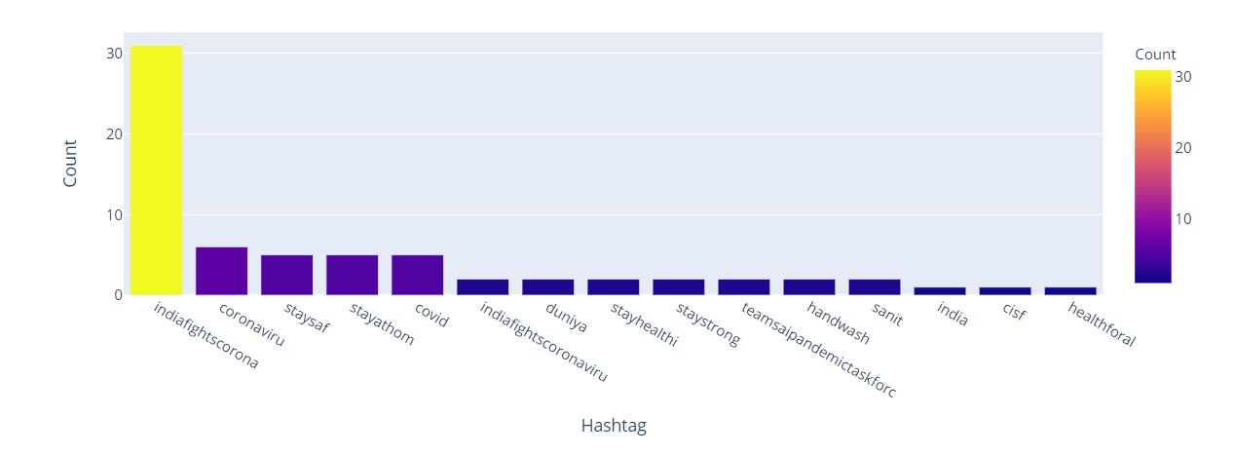
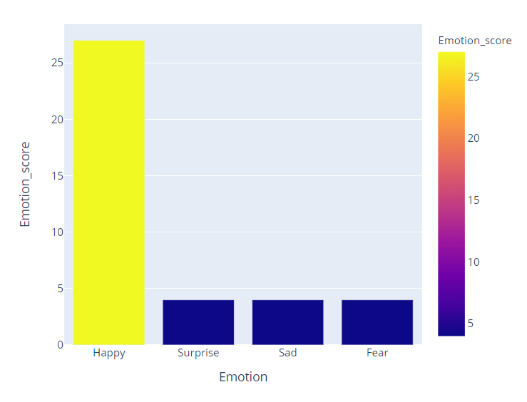
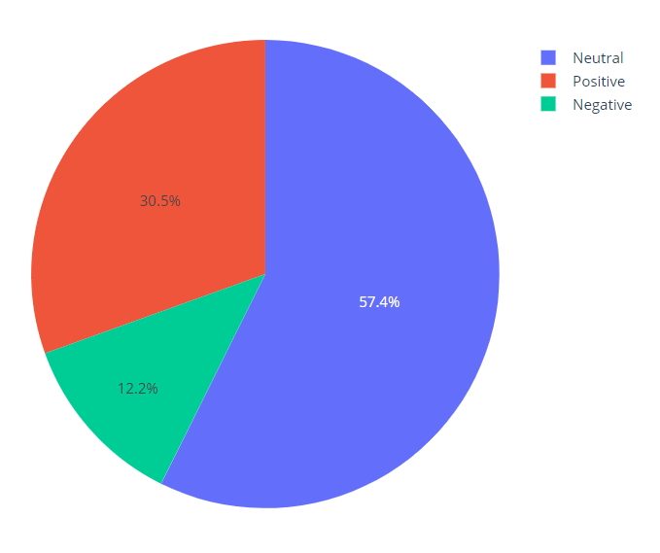
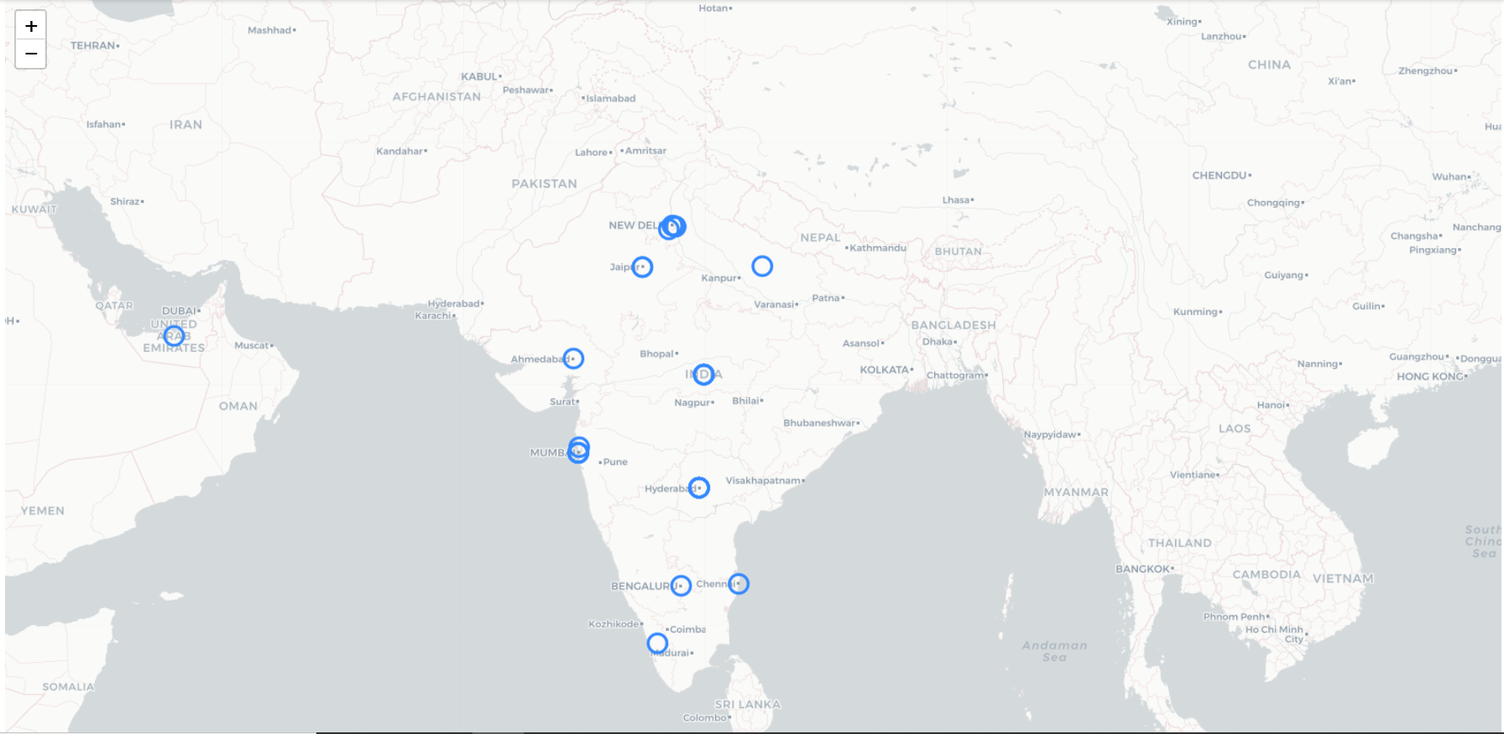
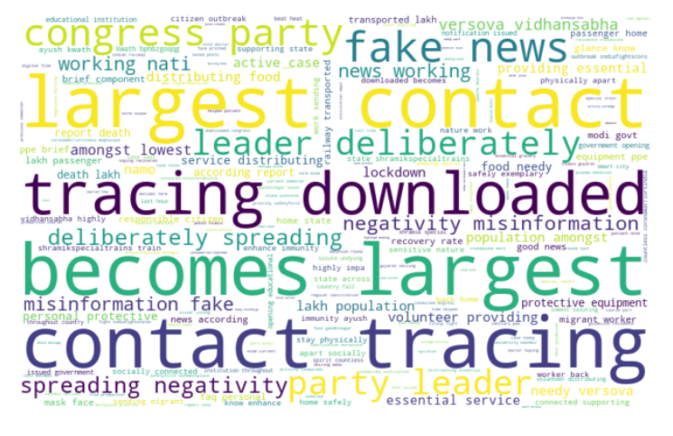
:
Data Visualizations
Hashtags Count
Emotion Analysis
Sentiment Analysis
Word Cloud
Geocode Location Map

Slide 7
Thank you!

